Slide 1
CERB & SOCIAL SUPPORTS NAVIGATOR BRIEFING current as of 07 april 2020
briefing Objectives
REVIEW OF CERB AFTER april 6
UPDATES & FEEDBACK FROM PARTICiPANTS WHO HAVE TESTED THE SYSTEM
Train Navigators – through situational analysis
Id gaps in the system using race & poverty lens (WHO ARE THOSE WHO FALL THORUGH THE CRACKS?)

Slide 2
Big picture
OIL PRICE WAR
= RECESSION

Slide 3
FEDERAL GOV’t economic RESPONSE
March 25, 2020 announcement:
Proposed Legislation: CERB – Emergency Response Benefit Act
Policy Goals:
To support workers and help businesses keep their employees
Put money in the pockets of Canadians as fast as possible ( timely access to income support)
Augment the capacity of the EI system to process the high volume of applications received in the past week

Slide 4
REference: CANADA.CA & CRA
A. LiNKS:
CERB: https://www.canada.ca/en/department-finance/economic-response-plan.html
CRA COVID-19: Changes to Canadian taxes and benefits : https://www.canada.ca/en/revenue-agency/campaigns/covid-19-update.html
B. Special assistance link:
Canada.ca/service-canada-e-service

Slide 5
B. Special assistance link: Canada.ca/service-canada-e-service

Slide 6
B. Special assistance link: Canada.ca/service-canada-e-service

Slide 7
Canada revenue agency
April 3, 2020
The Agency has updated information on the Canada Emergency Response Benefit, and the Goods and services tax/harmonized sales tax (GST/HST) credit payment amounts.
You can now sign up for direct deposit or change your account information through many financial institutions.
March 31, 2020
The Agency has published information on the Deferral of GST/HST Remittances.
March 30, 2020
The Agency has updated information on income tax filing and payment dates.

Slide 8
Canada revenue agency

Slide 9
Canada revenue agency: online registration
Step 1
Step 2: click CRA register
Prepare your documents
social insurance number
2018 tax return, line 10100

Slide 11
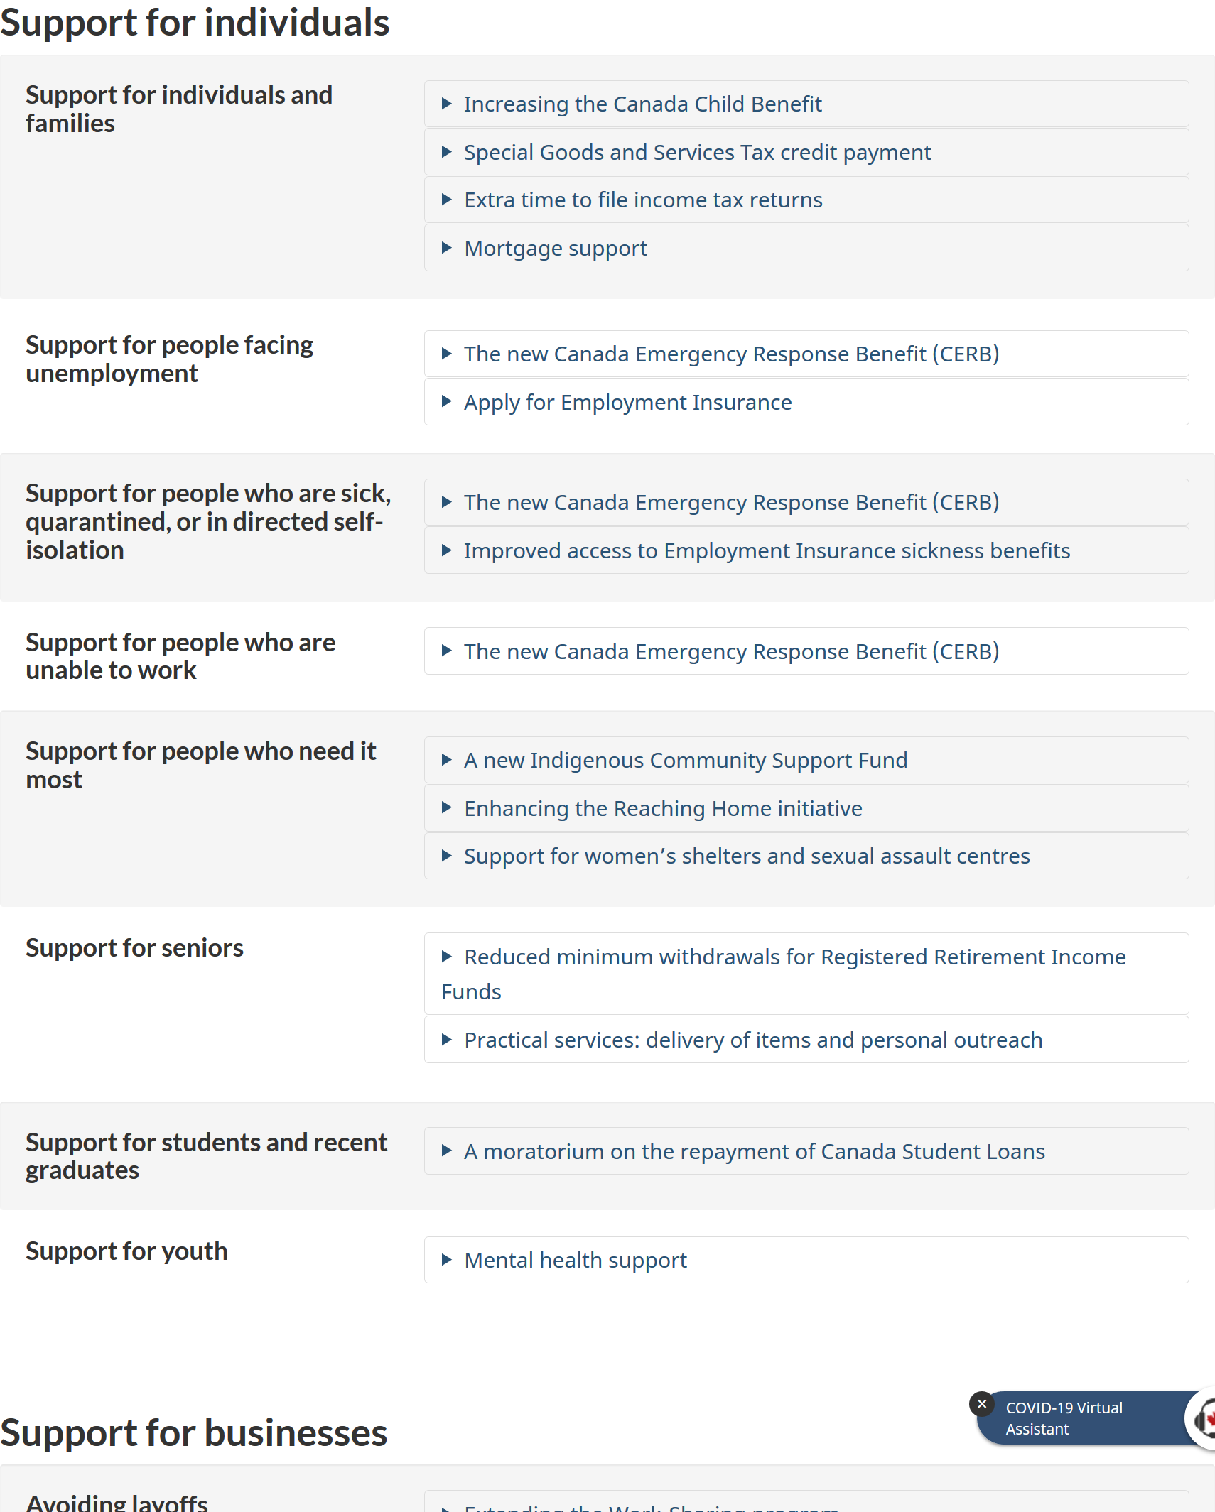

Slide 12
INCREASING CHILD BENEFIT
We are providing an extra $300 per child through the Canada Child Benefit (CCB) for 2019-20. This will mean approximately $550 more for the average family.
This benefit will be delivered as part of the scheduled CCB payment in May.
Those who already receive the Canada Child Benefit do not need to re-apply.

Slide 13
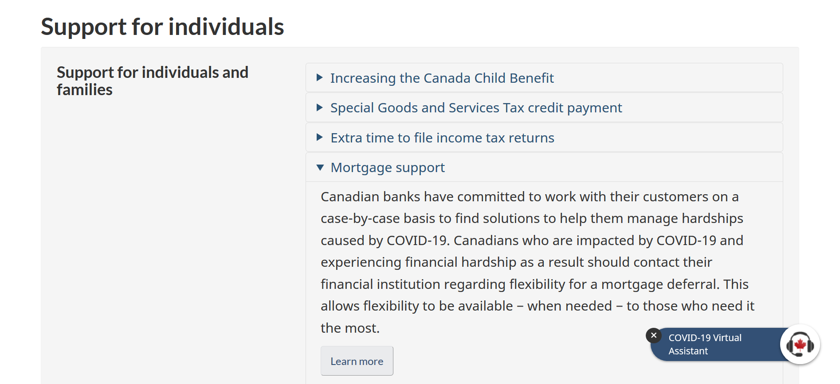

Slide 14
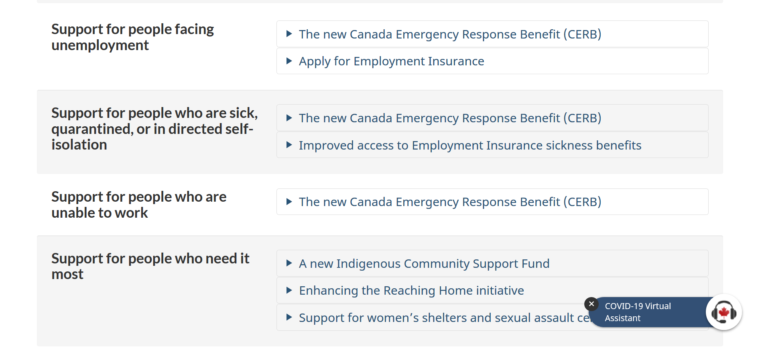

Slide 15
CANADA EMERGENCY RESPONSE BENEFIT CERB

Slide 16
Main features
Policy Target: all workers and employers
Simpler and more accessible (Emergency Care Benefit & Emergency Support Benefit)
CERB system does not replace EI system. It ENHANCES the capacity of the EI system.
Portal to apply opens ON April 6. Receipt of CERB payments will be 10 days of application.
$2,000 per month for 4 months
payment is every 4 weeks & available from March 15 until October 3, 2020.
Application under cerb shall be done every 4 weeks ( to update CRA of employment status)

Slide 17
CERB: ELIGIBLE WORKERS
https://www.canada.ca/en/services/benefits/ei/cerb-application.html
How to apply
Important! If you are not eligible for Employment Insurance, find out how you can get ready to apply for the CERB through the Canada Revenue Agency.
Whether you apply online or by phone, the CRA has set up specific days for you to apply. Please use the following guidelines:

Slide 20
CERB: ELIGIBILITY
The benefit will be available to workers:
Residing in Canada, who are at least 15 years old;
Who have stopped working because of COVID-19 and have not voluntarily quit their job;
Who had income of at least $5,000 in 2019 or in the 12 months prior to the date of their application; and
Who are or expect to be without employment or self-employment income for at least 14 consecutive days in the initial four-week period. For subsequent benefit periods, they expect to have no employment income.
The Benefit is only available to individuals who stopped work as a result of reasons related to COVID-19. If you are looking for a job but haven’t stopped working because of COVID-19, you are not eligible for the Benefit.

Slide 21
Eligibility QUESTIONS:
1. Where you working before March 15? = YES
2. Did you stop working due to COVID-19? = involuntarily quit job
3. Residence is Canada – but other source of income can come from outside Canada
4. Earned income (reported) in 2019 (Jan1-Dec.30) is = or > $5,000
5. Earned income in the 12 months BEFORE the date of application is = or > $5,000
Note: In requirements No. 4 & 5, you must be without employment or self-employment income for at least 14 consecutive days in the initial four-week period. For subsequent benefit periods, you expect to have no employment income.
The Benefit is only available to individuals who stopped work as a result of reasons related to COVID-19.
If you are looking for a job but haven’t stopped working because of COVID-19, you are not eligible for the Benefit.

Slide 22
$5,000 Earned income
The income of at least $5,000 may be from any or a combination of the following sources:
Employment
self-employment
maternity and parental benefits under the Employment Insurance program
alberta isolation supports program ($1,146)

Slide 23
PERSONAL SITUATION to ACCESS CERB

Slide 24
Situation a
gemma received EI benefits last year that expired on 15 June 2019.
gemma became self-employed (received cash payments/”under the table income” as house cleaner, car mechanic, massage therapist, hair dresser, gardener) bet Sept2019 to March 15, 2020 (date for #COVID-19 benefit kicks in).
Assuming gemma Has an earned income of $5,000 12 months prior to the date of #CERB application, IS gemma ELIGIBLE?

Slide 25
ANSWER
YES
PROVIDED:
SEE requirements No. 4 & 5: you must be without employment or self-employment income for at least 14 consecutive days in the initial four-week period. For subsequent benefit periods, you expect to have no employment income.
Other EXAMPLEs:
Example 1: Remy’s last day of work at the laundry shop is March 15. On March 30 (= at least 14 consecutive days), she was still unemployed due to COVID lockdown and is expecting to be unemployed. Remy is eligible under CERB and her benefit will retroact to March 15.
Example 2: Jessie is a self-employed Uber driver. He stopped receiving passengers (no calls) for fear of COVID spread so he has ZERO income for since March 20. Technically, as of today (April4) he is unemployed and is thus eligible. (Provided he has an earned income of at least $5,000 for 12 months before CERB application date)

Slide 26
Eligibility QUESTIONS: REVIEW
1. Where you working before March 15? = YES
2. Did you stop working due to COVID-19? = involuntarily quit job
3. Residence is Canada – but other source of income can come from outside Canada
4. Earned income (reported) in 2019 (Jan1-Dec.30) is = or > $5,000
5. Earned income in the 12 months BEFORE the date of application is = or > $5,000
Note: In requirements No. 4 & 5, you must be without employment or self-employment income for at least 14 consecutive days in the initial four-week period. After April 15, you expect to have no employment income.
The Benefit is only available to individuals who stopped work as a result of reasons related to COVID-19.
If you are looking for a job but haven’t stopped working because of COVID-19, you are not eligible for the Benefit.

Slide 27
Cerb beneficiaries: REVIEW
Canadian workers who
lost their job
sick or quarantined
taking care of someone who is sick with COVID-19
Working parents who must stay home without pay to care for children who are sick or because of school and daycare closures
Wage earners who would not otherwise eligible for EI
Contract workers who would not otherwise eligible for EI
Self-employed individuals who would not otherwise eligible for EI
Workers who are still employed, but are not receiving income because of disruptions to their work situation due to COVID-19 [ Intent: help business keep their employees while ensuring ability to resume operations once pandemic is over

Slide 28
SITUATION b: children who are sick or AT HOME because of school and daycare closures
Working parents (AND MAYBE GUARDIANS??)
who must stay home without pay = INVOLUNTARILY STOPPED WORKING
REASON FOR NOT WORKING: to care for children who are sick or because of school and daycare closurES DUE TO COVID
Example 1: weng work as caregiver in one of the seniors home. She stopped working for fear of covid contamination. Is she eligible?
Answer: no – because she quit her job voluntarily
Example 2: if weng has school age kids, and she stopped working because she is forced to take care of her children during closures, yes, she is eligible.

Slide 29
Situation c Wage earners/Contract workers who would not otherwise be eligible for EI
Example 1: Jessie works as a car mechanic at AutoNet and is paid per contract work by the owner. He does not pay EI/CPP thus ineligible for EI benefits. (He filed his 2019 tax return on March 5) If he stopped working due to shop closure on March 20, he is eligible under CERB if his:
a. Earned income (reported) in 2019 tax return (Jan1-Dec.30) is = or > $5,000
Example 2: If his 2019 tax return is $3,000 only, he still has the time to record his earned income between January- March 15 2020 to be eligible under the second clause:
“Earned income in the 12 months BEFORE the date of application” is = or > $5,000. To be eligible,
he has to show (good record-keeping of cash transactions!) that his earned income between Jan-March 15 2020 is $2,000 or more.

Slide 30
Situation d wage earners with 2 or more jobs!!
Example: Remy works fulltime in the laundry shop and works parttime at McDo. On March 25, her laundryshop employer gave them their ROE because there is no work for them for the next 2 weeks due to COVID lockdown. She continues working parttime at McDo. Is she eligible under CERB?
Answer: No. Remy must have stopped working due to COVID. Here, she is still earning income from Mcdo. However, she is eligible to receive EI albeit lower than what she could otherwise receive under CERB had she totally stopped working in both jobs. [Update: as of Apr. 6, Prime Minister Trudeau announced that the federal gov’t is reviewing the CERB to expand coverage to those with substantially reduced income. WE will update this accordingly]

Slide 31
reference: Canada.ca

Slide 32
EI Implications:
Those who are already receiving EI regular and sickness benefits as of March 25 are not eligible to apply under CERB.
Exception: If you are already receiving EI but your benefits end before October 3, 2020, you can apply under CERB. Example: If your EI benefits will end on July 1, you can apply under CERB on July 2. Provided, you are still unemployed on July 2.

Slide 33
EI implications
2. Those who have applied and application has not been processed yet, no need to re-apply for EI
3. If you have applied and receive benefits under CERB for 16 weeks, and remains unemployed after this period, you can still access your regular EI benefits
For example, if you started receiving CERB benefits on April 1 and remains unemployed on July 22 (date around the 16-week mark), you can apply for your regular EI benefits after the 16-week CERB benefits expire

Slide 34
Questions? ActionDignity COVID 19 benefits navigator guide, April 7, 2020 for questions and support, please email: Meriam, actiondignity at research.policy.educator@actiondignity.org

