Slide 1
Racism and COVID-19
April 15, 2020
© 2019 Alberta Association of Immigrant Serving Association (AAISA).

Slide 2
Territorial Acknowledgement

Slide 3
Funder Acknowledgement

Slide 4
Introductions
Tyra Erskine, Pronouns: She/her
Ethno-racial identity: Jamaican/Scottish/Metis
Program Coordinator - People’s CAFE
(Coalition to Advance Fairness and Equity)
Email: tyra.erskine@actiondignity.org
Jayde Roche, Pronouns: She/her
Ethno-racial identity:
Trinidadian/British/Norwegian
Program Manager - Rural Immigration
Email: jayder@ardn.ca

Slide 5
Objectives
View the COVID-19 Pandemic through an anti-racism lens
Develop an understanding of current human rights implications of COVID-19
Recognize how COVID-19 has been framed in the media
Become familiarized with actions people can take to support their mental health and wellbeing

Slide 6
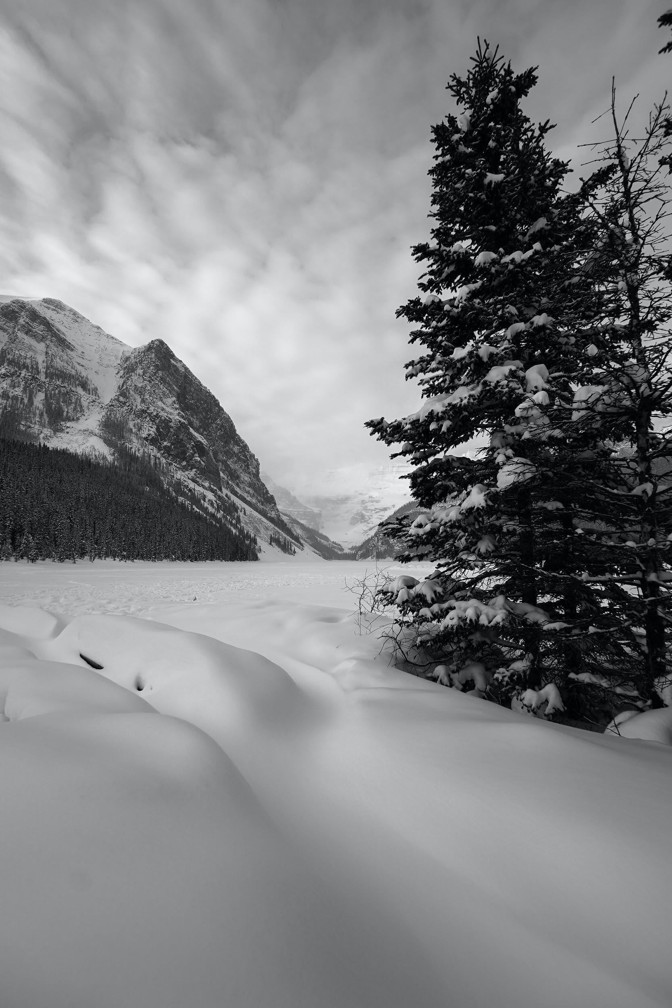
Webinar Outline
Photo by Mathew Krizmanich on Unsplash

Slide 7
Accountable Spaces
Respect the space and others
Acknowledge that this is a safe space for participants
Individuals experience racism in different ways
Recognize that each experience and viewpoint is valid even if they differ. Consider that you do not need to agree with a perspective in order to understand it.
Power and privilege
Examine your own privilege and be aware of potential power dynamics that you might contribute to within this space.
A place of learning & self reflection
Recognize that we are all in a place of learning.
Take care of yourself
Think of someone you trust whom you can debrief with and plan to contact them.
Adapted from CommunityWise

Slide 8
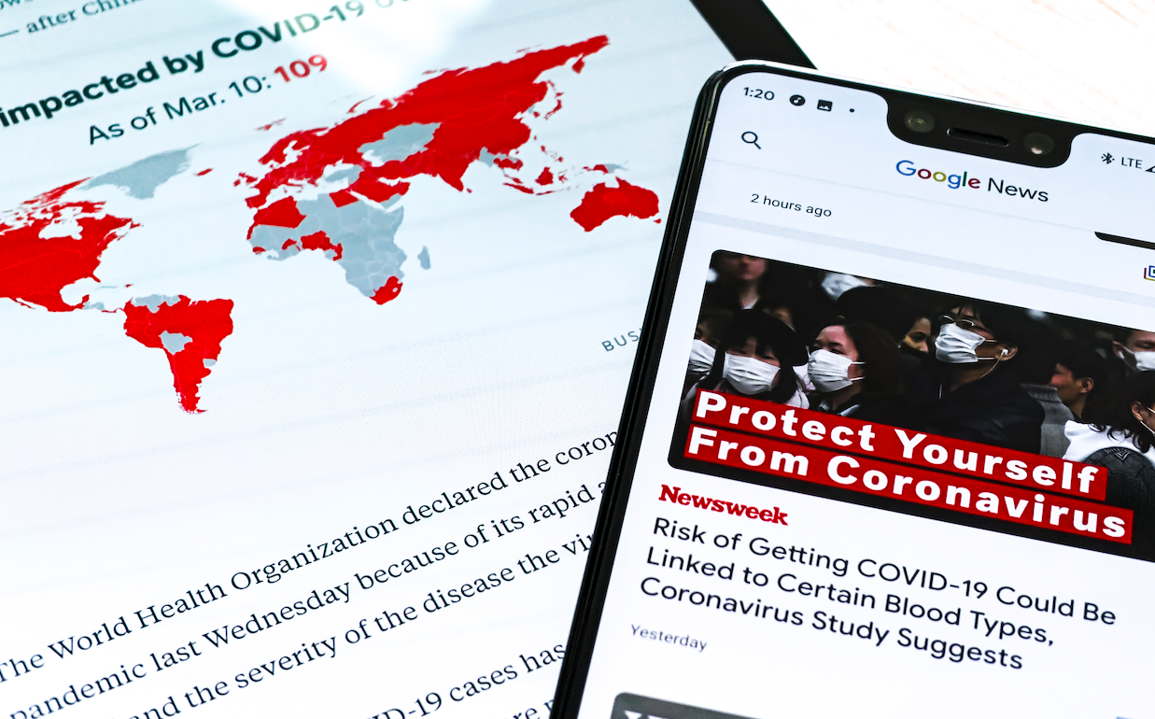
Poll
Are you attending this webinar as:
Individual
Member of a settlement agency
Member of an organization
Member of a small group
How up to date do you feel you are on COVID-19?
I am very up to date
I am mostly up to date
I am seldom up to date
I know very little
Have you observed an increase in racism and xenophobia as a result of COVID-19?
Yes
No
Unsure
Photo by Obi Onyeador on Unsplash

Slide 9
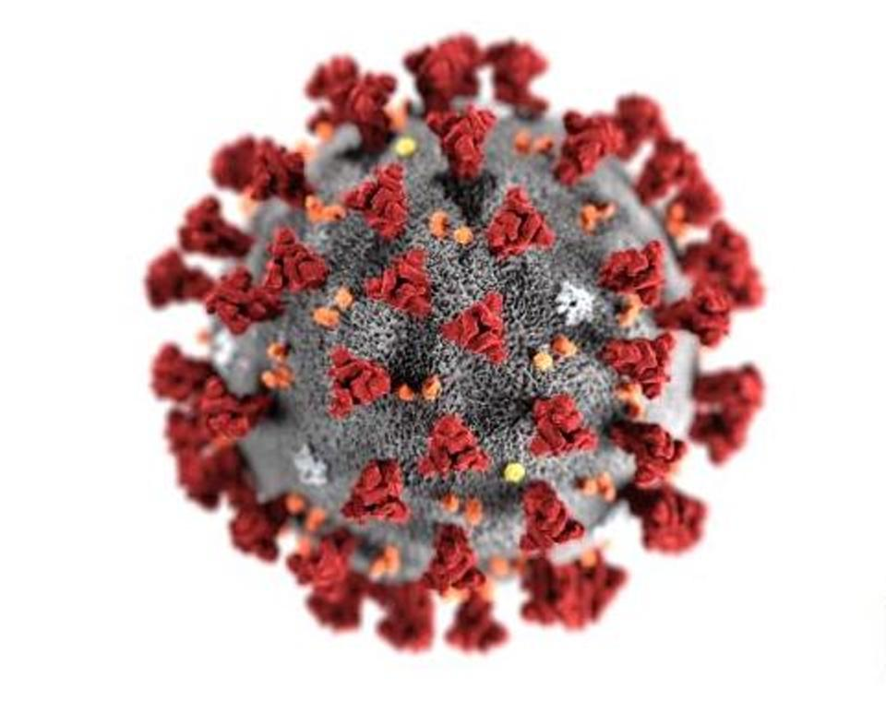
What is COVID-19?
According to Health Canada, coronaviruses are a large family of viruses.
COVID-19 is a new disease that has not been previously identified in humans. (Health Canada)
Image: https://www.forbes.com/sites/tarahaelle/2020/02/13/covid-19-would-a-coronavirus-by-any-other-name-seem-less-scary/#51948c6a1dbc
For more information on COVID-19 please visit https://www.canada.ca/en/public-health/services/diseases/coronavirus-disease-covid-19.html

Slide 10
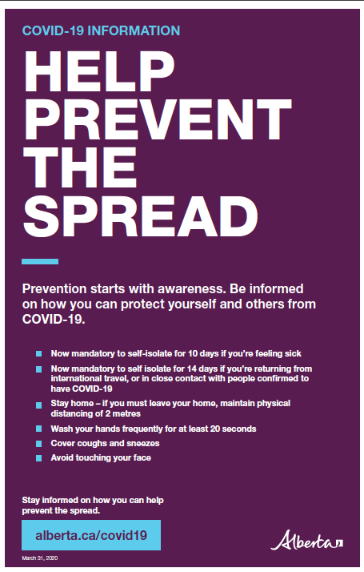
COVID-19 in Alberta
March 5 2020
First case in Alberta reported
Dr. Deena Hinshaw announced the province’s first case of the novel coronavirus.
March 15 & 17 2020
Closure of schools and daycares
March 17, the premier declared a state of public health emergency in Alberta over the novel coronavirus pandemic.
March 27 2020
Non-essential businesses close
The premier ordered the closure of non-essential businesses and the province announced further restrictions on mass gatherings.
Today
Preventing the spread
Image source: https://open.alberta.ca/dataset/80c3fda3-7bd8-41c2-8724-c476c1b54a5b/resource/9a5ea22c-2490-47f3-8b02-7df3d2fc4669/download/covid-19-prevention-starts-with-awareness-poster-11x-17-colour.pdf
Alberta has continued to implement new restrictions and guidelines to help prevent the spread of COVID-19

Slide 11
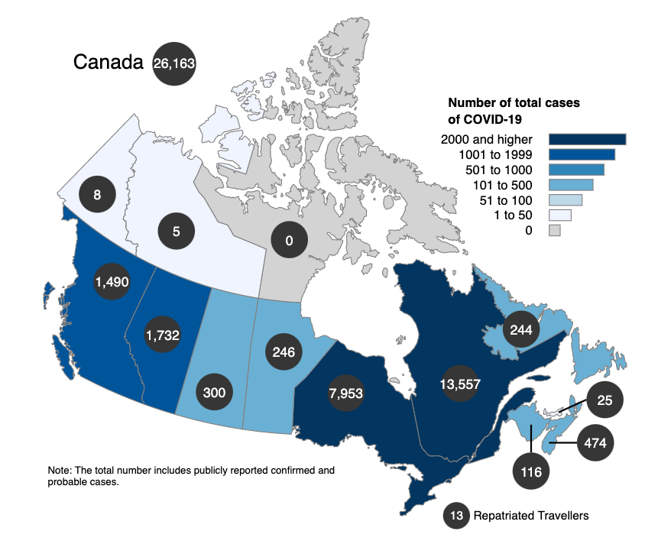
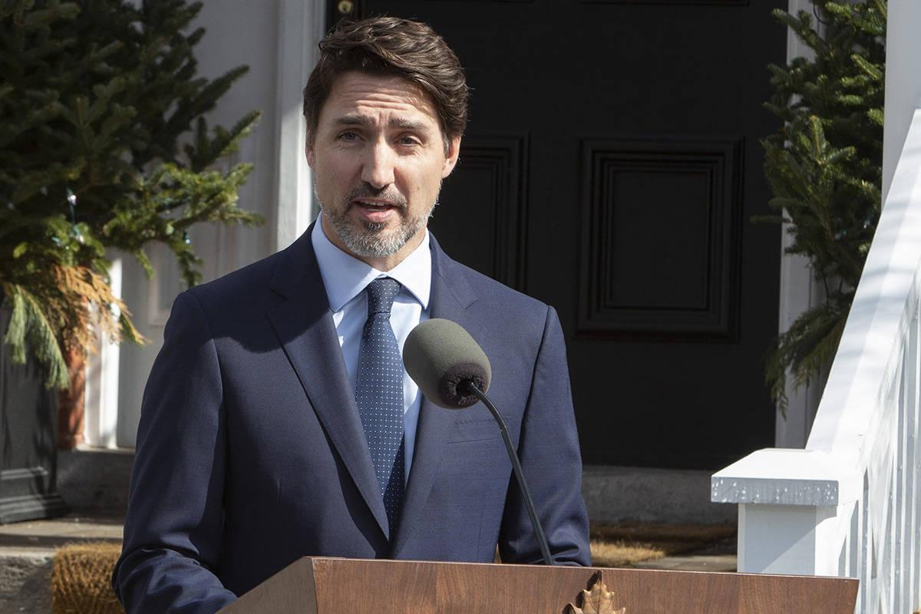
COVID-19 in Canada
Last Data Update 2020-04-14 11:00 EDT
Source: https://www.canada.ca/en/public-health/services/diseases/2019-novel-coronavirus-infection.html?topic=tilelink

Slide 12
COVID-19 & The Alberta Human Rights Act
Discrimination related to COVID-19 is prohibited when it involves a ground under the Alberta Human Rights Act
Restrictions based on where a person has recently travelled
Services that have restricted hours for seniors or vulnerable individuals
Making assumptions about an individuals exposure to COVID-19 based on race, place of origin or ethnic origin
For more information please visit https://www.albertahumanrights.ab.ca/employment/Pages/covid19.aspx

Slide 13
Canadian Human Rights Commission
“The Canadian Human Rights Commission is deeply concerned by the rise of racism across Canada since the start of the COVID-19 pandemic.”
“Minority groups, in particular people of Asian origin have been the victims of racist taunts, threats and intimidation in public and online, and physical violence. This is both an issue of public safety and fundamental human rights. No one should feel threatened or unwelcome because of the colour of their skin or where they are from.”
Statement from Marie-Claude Landry, Chief Commissioner of the Canadian Human Rights Commission

Slide 14
Key Terms & Findings

Slide 15
Xenophobia
Racism
Racialization
Xenophobia describes attitudes, prejudices and behaviour that reject, exclude and often vilify persons, based on the perception that they are outsiders or foreigners to the community, society or national identity (UNHCR)
Racism is an individual action or institutional practice backed by institutional power, which subordinates people because of their colour or ethnicity. (Anti-Racism Resource Centre, Community and Race Relations Committee of Peterborough)
Racialization is the process through which groups come to be socially constructed as races, based on characteristics such as race, ethnicity, language, economics, religions, culture, politics, etc. That is, treated outside the norm and receiving unequal treatment based upon phenotypical features. (Canadian Race Relations Foundation)

Slide 16
Discrimination
Discrimination is an action or a decision that results in the unfair or negative treatment of a person or group, for reasons such as their race or age. (CHRC)

Slide 17
COVID-19 Survey
Purpose:
Identify needs
Locate gaps, issues, and opportunities for improvement
Share positive experiences
Identify actions that are helping communities respond to COVID-19

Slide 18
Survey Insights: 117 Reponses
71%
65%
89%
of respondents thought it was extremely important for them to have COVID-19 information available in their first language
of respondents thought Websites were the most important way to share information
of respondents have avoided going to crowded places in the last 5 days
60% thought that Facebook was the second most important
The other top actions taken were:
Cancelled or postponing face-to-face meetings workshops, activities
Discussing with others how COVID-19 is affecting their community
Increasing online presence, livestreaming
Urdu, Punjabi, Tagalog, Spanish, Cantonese, Vietnamese, Chinese, Amharic, Farsi, Gujarati, Kutchi.
The other most useful ways are:
Emails
WhatsApp

Slide 19
Racism and Health

Slide 20
Content Warning
A content warning is used to warn attendees of upcoming information that they might find triggering or upsetting
Discussion of Anti-Asian Racism & Xenophobia
Discussion of Anti-Black Racism and Xenophobia
Vestibulum congue tempus
Vestibulum congue tempus
Discussion of Anti-Indigenous Racism
Discussion of Incarceration and the carceral state
Content will include specific examples of racism, xenophobia, and hate.
Content will include specific examples of Mass Incarceration and medical exploitation.
Content will include specific examples of racism and hate.
Content will discuss mass incarceration and the living conditions in prisons.

Slide 21
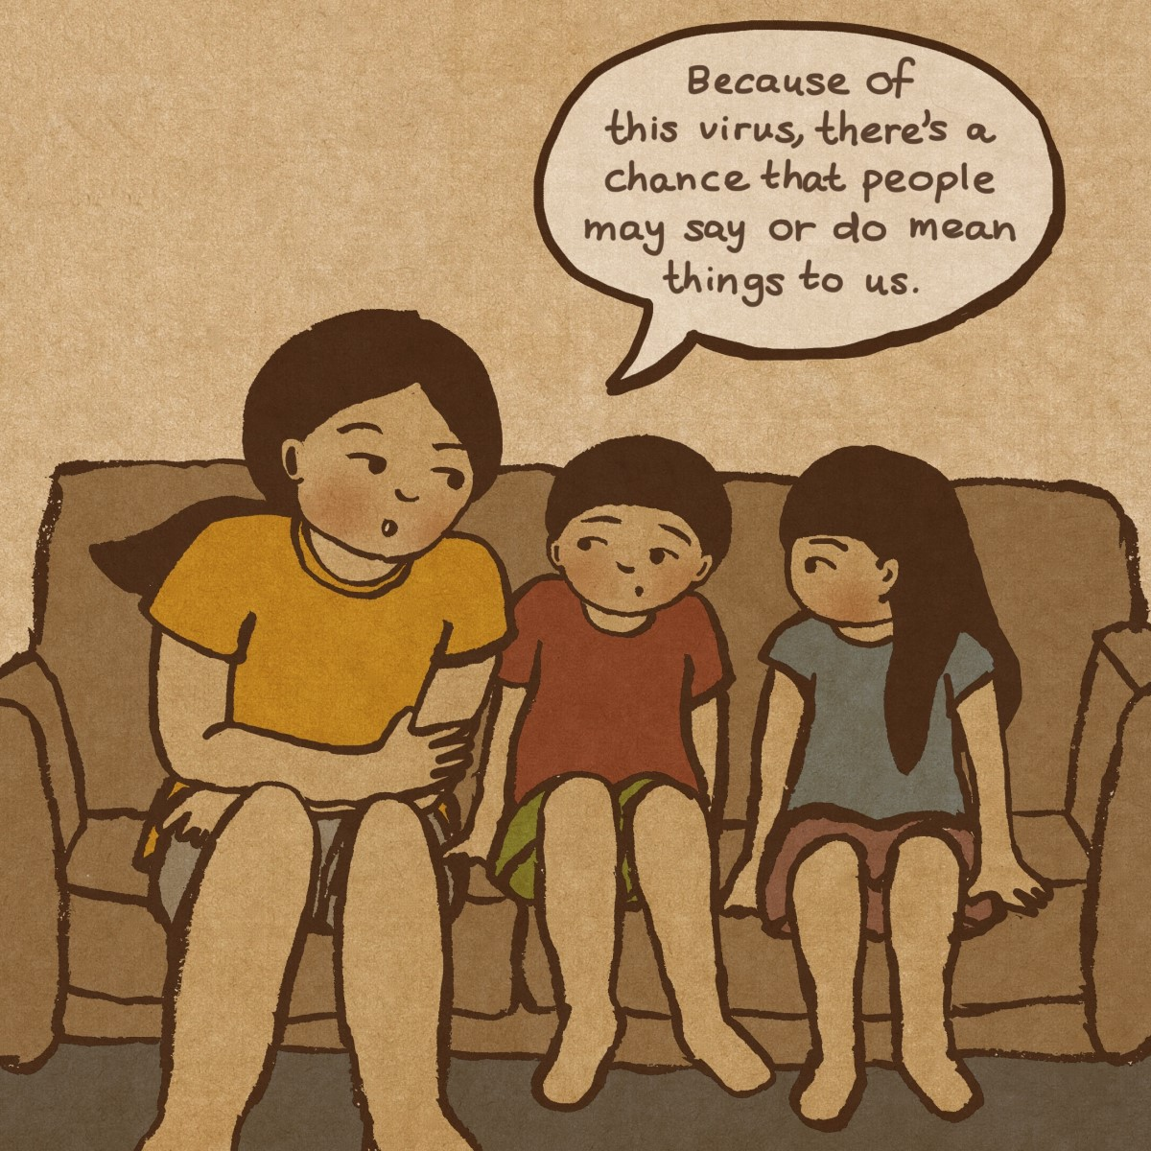
Anti-Asian Racism and Xenophobia
By Lisa Wool-Rim Sjöblom, a Korean-Swedish artist
The Asian community went “from being invisible” to being “hyper-visible, but as a virus or as a carrier of a virus,” said Sjöblom.
For more information please visit
https://www.pbs.org/newshour/arts/i-am-not-a-virus-how-this-artist-is-illustrating-coronavirus-fueled-racism

Slide 22
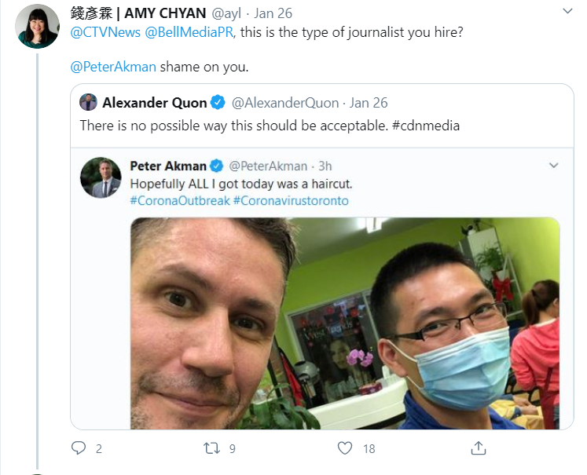
Anti-Asian Racism and Xenophobia

Slide 23
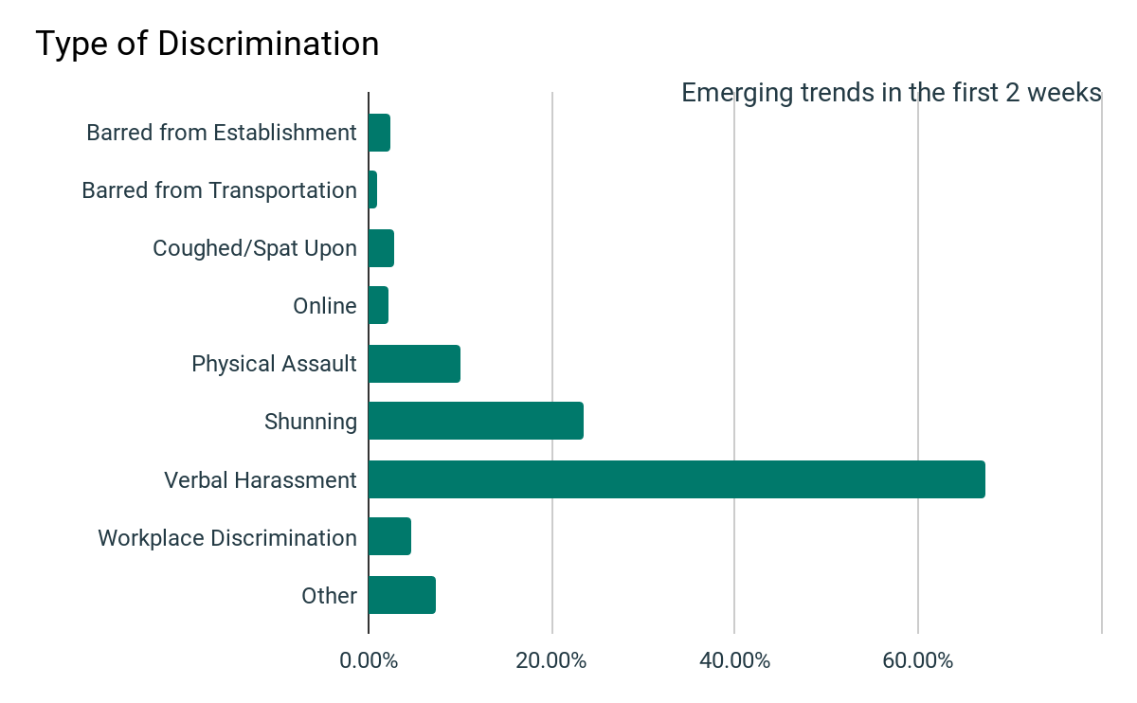
Anti-Asian Racism and Xenophobia
According to a report by Asian Pacific Policy and Planning Council, there have been 1100 reports of COVID-19 discrimination submitted to the website since March 19, 2020.

Slide 25
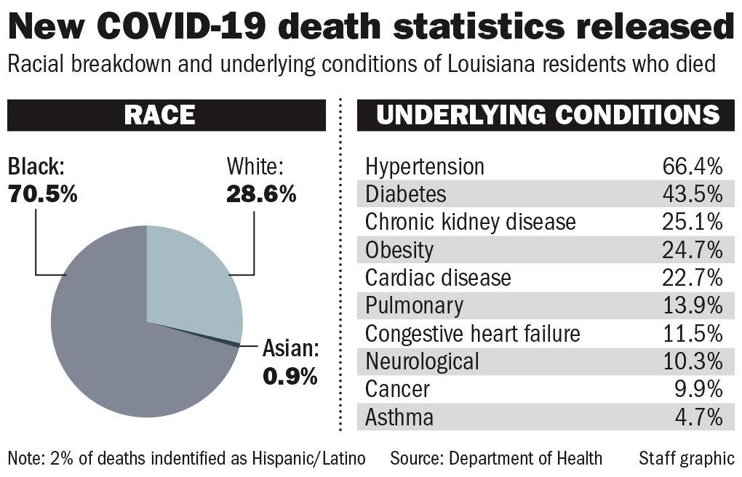
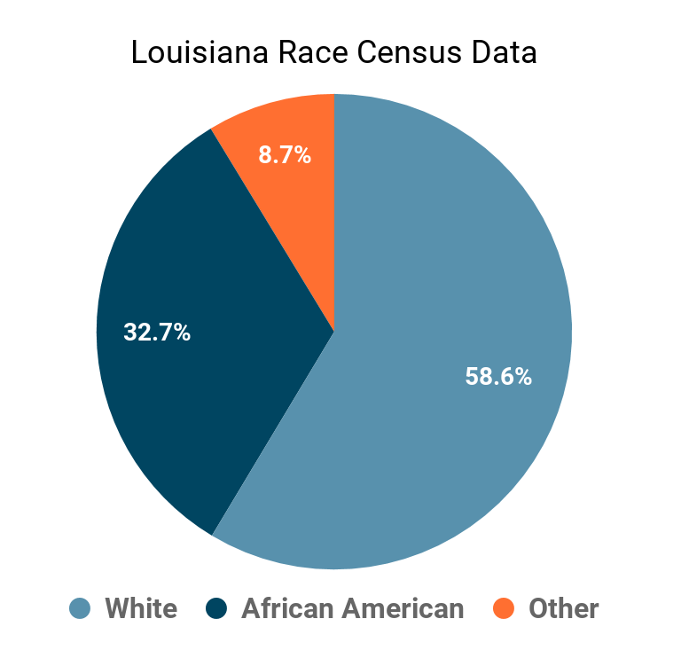
Anti-Black Racism
For more information on COVID-19 please visit http://ldh.la.gov/Coronavirus/

Slide 26
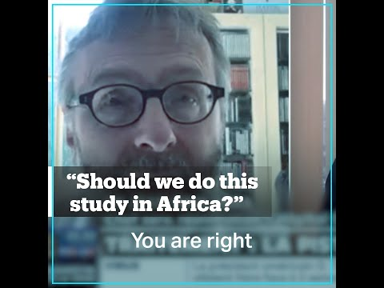
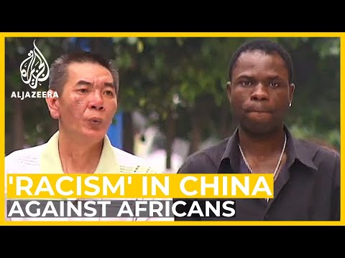
Anti-Black Racism and Xenophobia
Content Warning: medical experimentation, anti-sex worker dialogue

Slide 28
Anti-Indigenous Racism
Calgary police investigate COVID-19 threats to local business, Indigenous populations:
“In the second case, a man allegedly commented on an Indigenous group’s social media page, threatening to intentionally spread the virus to Indigenous people, police said.”
For more information on COVID-19 please visit https://globalnews.ca/news/6763822/calgary-police-coronoavirus-threats-indigenous/

Slide 29
Anti-Indigenous Racism
“If your community is on a boil water advisory or do not consume advisory you should still use your water to wash your hands with soap and water and for personal hygiene. Infants and toddlers should be sponge bathed in order to avoid accidentally swallowing the water.
If you are on a do not use advisory, your water is not safe for any use. Use bottled water with soap or hand sanitizer with at least 60% alcohol to wash your hands.
If you do not have access to running water, wash your hands in a large bowl and then throw out the water from the hand washing bowl after each individual use“
For more information on COVID-19 please visit https://www.sac-isc.gc.ca/eng/1581964230816/1581964277298

Slide 30
Anti-Indigenous Racism
Specific Challenges with COVID-19
Lack of clean drinking water in some areas
This makes frequent hand washing impossible
As of October, 2019, there were almost 100 reserves with “boil water advisories”.
Some homes on reserves do not have running water
Overcrowding in houses
Inability to effectively self-isolate
Distance
there are 96 remote fly-in Indigenous communities across Canada.
Indigenous People were disproportionately affected by H1N1

Slide 31
Anti-Indigenous Racism
“A single case in any First Nations, Inuit or Métis community is high cause for concern. These communities are among the most vulnerable to COVID-19 due to distances, access to necessary resources and underlying health conditions,”
Canada's Chief Public Health Officer Dr. Theresa Tam on April 7, 2020
For more information please visit https://www.cbc.ca/news/politics/stefanovich-federal-indigenous-covid19-support-1.5503079

Slide 32
What does Incarceration in Canada Look Like?
Indigenous Peoples account for 5% of the total Canadian population and yet account for 30% of the federal incarcerated population
Black people account for 3.5% of the total Canadian population and account for 7.3% of the federal incarcerated population.
For more information please visit https://www.oci-bec.gc.ca/cnt/comm/press/press20200121-eng.aspx
Racism
Health
Incarceration

Slide 33
Incarceration, Racism, and Health
Edmonton Institution inmate punished for speaking to media about COVID-19, lawyer says
'It's horrifying': Physicians and lawyers say coronavirus outbreak at B.C. prison could have been prevented
Positive Tests | Negative Tests | Pending Tests | Total Tests
82 | 205 | 26 | 313

Slide 34
Racism and xenophobia response strategies
Recognize
Recognize comments or media that have racist or xenophobic bias
Interrupt
Question
Educate
Echo
“Hang on. I want to go back to what you called the virus.”
“Why did you call the virus that?”or “Where did you hear that information?”
Understanding the history and harm of associating diseases with a specific place or group of people from a region
When someone else speaks up, amplify or echo their messages
Adapted from TeachingTolerance.org

Slide 35
Racism and xenophobia response strategies
Individual level
Challenging racism and xenophobia online (as per previous slide)
If in person, asses whether it is possible for you to safely engage at a distance
Pressuring political leaders to address the Anti-African racism currently happening in China (currently only African leaders have spoken out on this)
Donating
Educate others on the Anti-Asian racism and xenophobia that is amplified because of COVID-19
Institutional level
Prepare for the likelihood of more COVID-19 outbreaks in prisons - the only solution is to reduce the prison population
Future preventative actions to protect Indigenous Peoples living on reserves

Slide 36
Self-care and Community-care during the COVID-19
"Self-care". Illustrations by Paru Ramesh

Slide 37
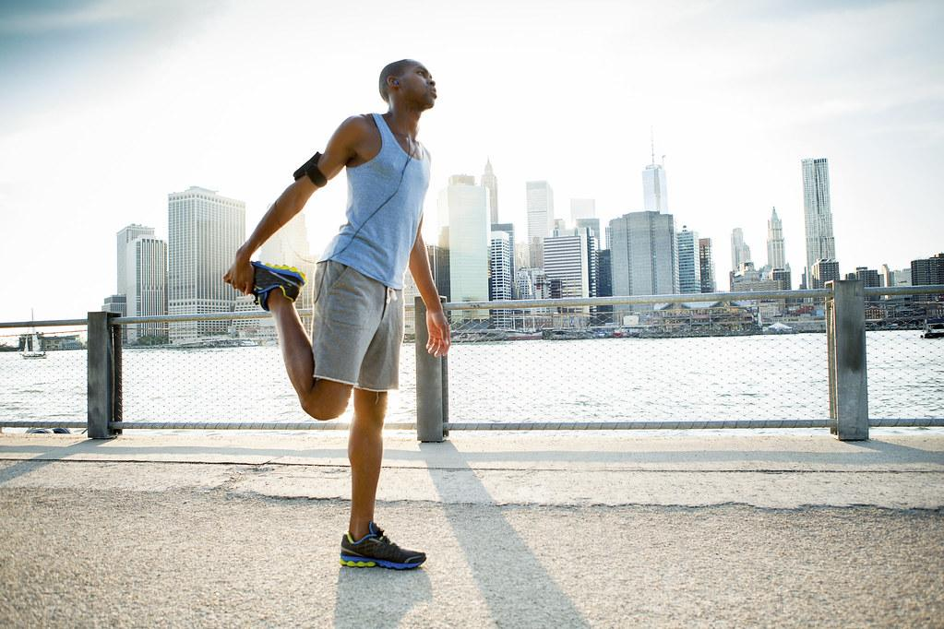
Poll
How many times are you having physical activity each week?
None
1 time
2-3 times
over 3 times
How many times per week are you having significant social interaction?
None
1 time
2-3 times
Over 3 times
How have you been impacted emotionally by the COVID-19? (Select all that apply)
Feeling isolated and lonely
Feeling stressed and afraid
Feeling depressed and anxious
Feeling overwhelmed by work responsibilities
Feeling good
Feeling guilt

Slide 38
What are people saying?
“People are very overwhelmed with fear, affecting their mental and interpersonal relationships. Some who are already isolated become even more isolated”.
Concerns for those who are experiencing domestic violence. Without support and the ability to leave the house, these numbers will likely increase.
“Mental and emotional well-being and establishing a healthy and productive routine”.
Some people mentioned that this is their first year in Canada and that they feel very scared and isolated

Slide 39
Mental health concerns and impact
Concerns:
Isolation
Fear
Economic instability
Trauma
Inability to leave the house
Impacts:
Anxiety and depression
Hopelessness
Stress
Loss of control
Kids being unable to focus during school online
Increased rates of domestic violence
“When ‘I’ is replaced with ‘we’, even illness becomes wellness.”
Malcolm X

Slide 40
Resource Package
Support the sharing of reliable information
trusted sources
multiple languages
easy to share on social media: infographics, tips sheets, posters, videos
themes communities want
Help communities raise awareness of supports they can provide
Share inspiring stories of community action
Avalable at https://actiondignity.org/community-resource-package/

Slide 41
Tips and Strategies
Mind
Work/life balance
Separate weekends
Incorporate “travel time” into your day
Have a creative outlet - work on your hobbies
Body
Eating well
Working out and going for walks
Emotional
Grieve
Research online therapy
Open up to friends about how you are feeling
Practice mindfulness
Find organizations that can help with any needs you have
Do not blame yourself if you are unable to do any of these
Find online communities
Social
Connecting with others
Muting social media as needed

Slide 42
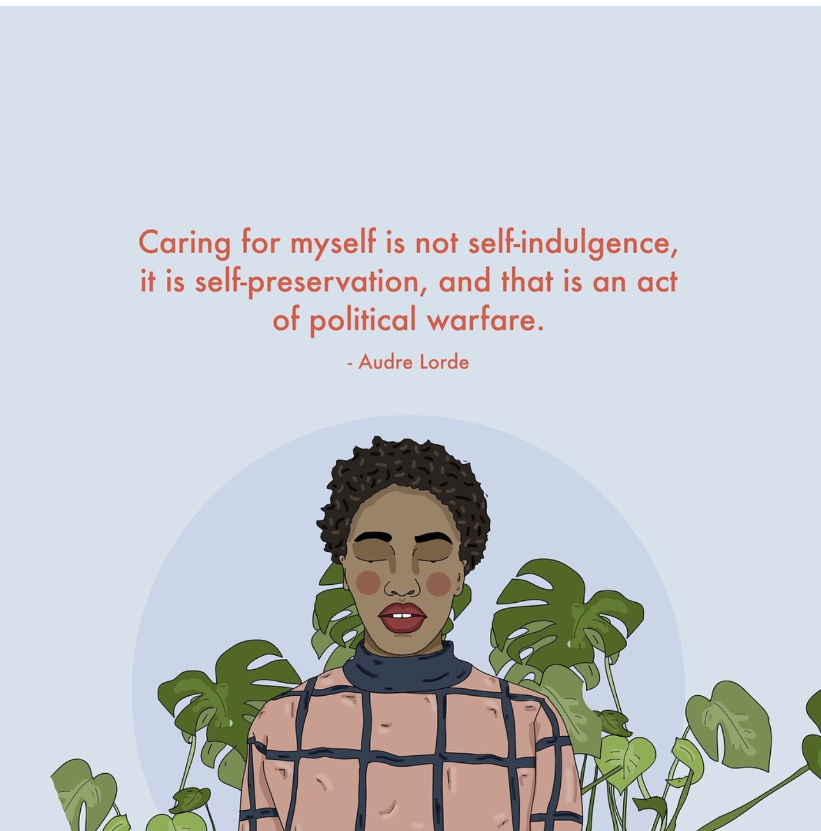
Rest
By Alison Rachel, from Recipes for Self-Love

Slide 43
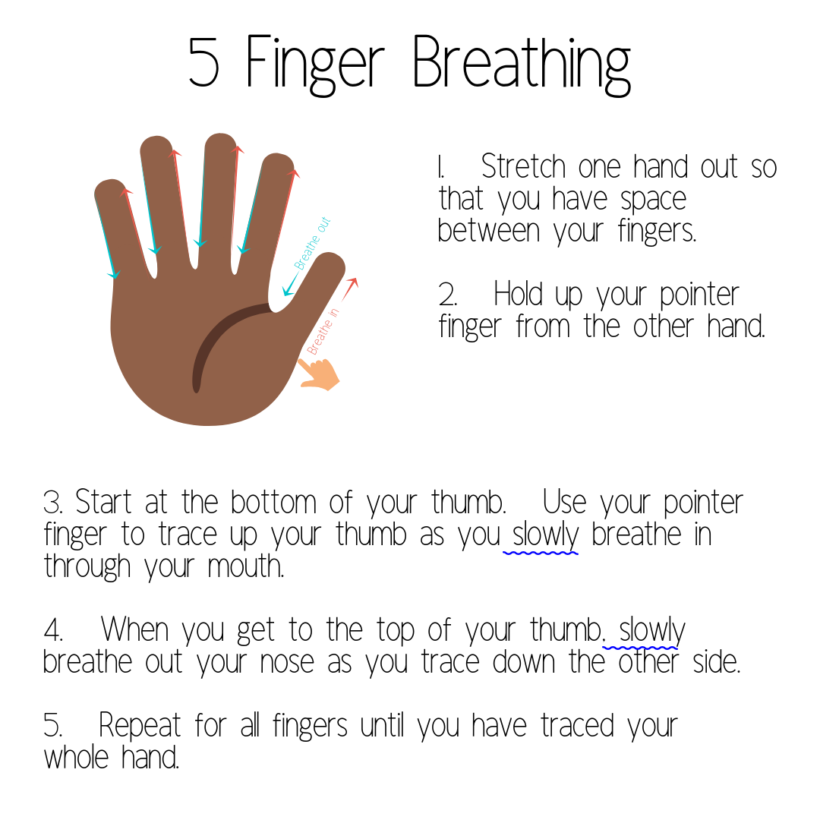
Self Care Activity
Source: The Calming Cornner http://www.thecalmcorner.com/2018/11/material-share-monday-calming-tools.html

Slide 44
Poll
Do you plan to use any of the mental health tips and strategies shared in this webinar?
Yes
No
Unsure
Do you plan to use any of the the racism and xenophobia responses strategies?
Yes
No
Unsure
How likely are you to attend a part two COVID-19 and racism webinar?
Very likely
Likely
Unlikely
Very unlikely
Image credits: <a href="https://www.freepik.com/free-photos-vectors/background">Background vector created by rawpixel.com - www.freepik.com</a>

Slide 45
Questions?
Source: https://www.pngfuel.com/free-png/njjcq

Slide 46
Contact Information
Tyra Erskine, ActionDignity
Email: tyra.erskine@actiondignity.org
Address: 915 - 33 Street NE | Moh’kins’tsis | Treaty 7 Territory | Calgary
website: www.actiondignity.org
Jayde Roche, Alberta Rural Development Network
Email: jayder@ardn.ca
Address: 200, 10578 113 St. I Treaty 6 Territory I Edmonton
Website: www.ardn.ca

Slide 47
Thank you
For more information on upcoming anti-discrimination webinars in this series, including dates and registration, please visit the “Professional Development” page on AAISA’s website at www.aaisa.ca

Slide 48
COVID-19 Related Racism and Xenophobia Poll
Access Here

Slide 49
References
ActionDignity Survey & Community Resource Package
Garcia, S. (2020, April 1) ‘I am not a Virus’ How the Artist is Illustrating Coronavirus-fueled Racism. https://www.pbs.org/newshour/arts/i-am-not-a-virus-how-this-artist-is-illustrating-coronavirus-fueled-racism
Jeung, R (2020, March 25) Incidents of Coronavirus Discrimination. http://www.asianpacificpolicyandplanningcouncil.org/wp-content/uploads/A3PCON_Public_Weekly_Report_3.pdf
Louisiana Department of Public Health (2020) Coronavirus (COVID-19) Retrieved on April 10, 2020 from http://ldh.la.gov/Coronavirus/
United States Census Bureau (2019, July 1) Quick Facts: Louisiana. Retrieved from https://www.census.gov/quickfacts/fact/table/LA/PST045219
Knight, D (2020, April 1) Calgary police investigate COVID-19 threats to local business, Indigenous populations. https://globalnews.ca/news/6763822/calgary-police-coronoavirus-threats-indigenous/
Government of Canada (2020) Coronavirus (COVID-19) and Indigenous communities. https://www.sac-isc.gc.ca/eng/1581964230816/15819642772987
CommunityWise Resource Centre (2017). Anti-Racist Organizational Change: Resources & Tools for Nonprofits. http://communitywise.net/wp-content/uploads/2017/10/AROC-Resources-and-Tools_web.pdf
Government of Canada (2020) Coronavirus disease (COVID-19). https://www.canada.ca/en/public-health/services/diseases/coronavirus-disease-covid-19.html
Government of Alberta COVID-19 Information. https://www.alberta.ca/coronavirus-info-for-albertans.aspx
Prime Minister outlines Canada’s COVID-19 response. (1970, January 1). Prime Minister of Canada. https://pm.gc.ca/en/news/news-releases/2020/03/11/prime-minister-outlines-canadas-covid-19-response
COVID-19 and Human Rights. (n.d.). Retrieved April 14, 2020, from https://www.albertahumanrights.ab.ca/employment/Pages/covid19.aspx
Statement—Racism in response to COVID-19 harms us all. (n.d.). Retrieved April 14, 2020, from https://www.chrc-ccdp.gc.ca/eng/content/statement-racism-response-covid-19-harms-us-all
Coronavirus: The life-and-death consequences of naming the disease—Vox. (n.d.). Retrieved April 14, 2020, from https://www.vox.com/2020/2/14/21135208/coronavirus-wuhan-china-covid-19-name-sars-cov-2
How to Respond to Coronavirus Racism. (2020, March 20). Teaching Tolerance. https://www.tolerance.org/magazine/how-to-respond-to-coronavirus-racism

